Slide 1
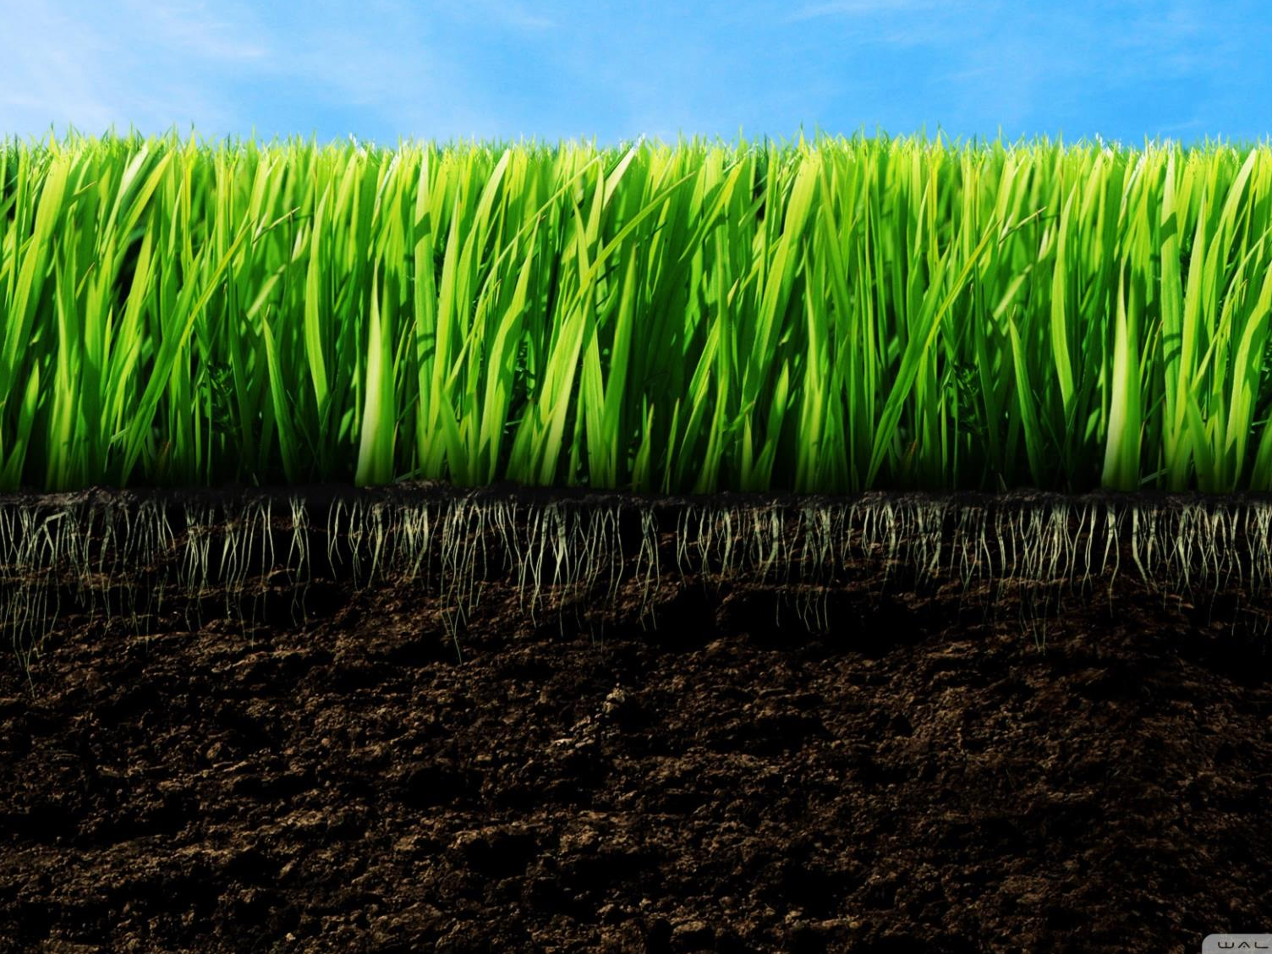
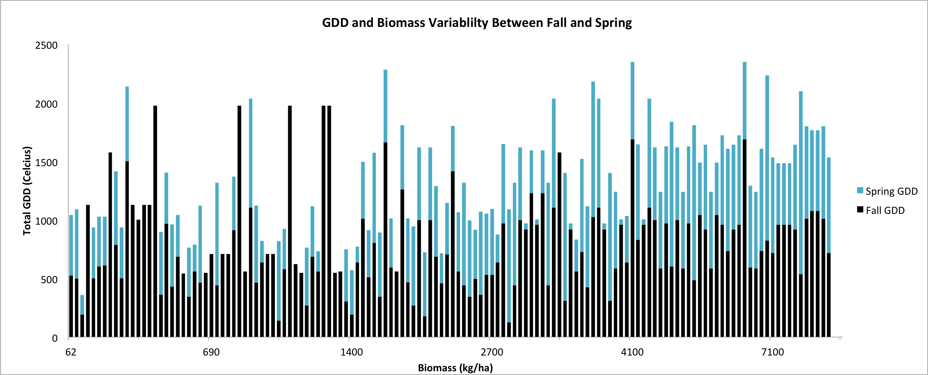
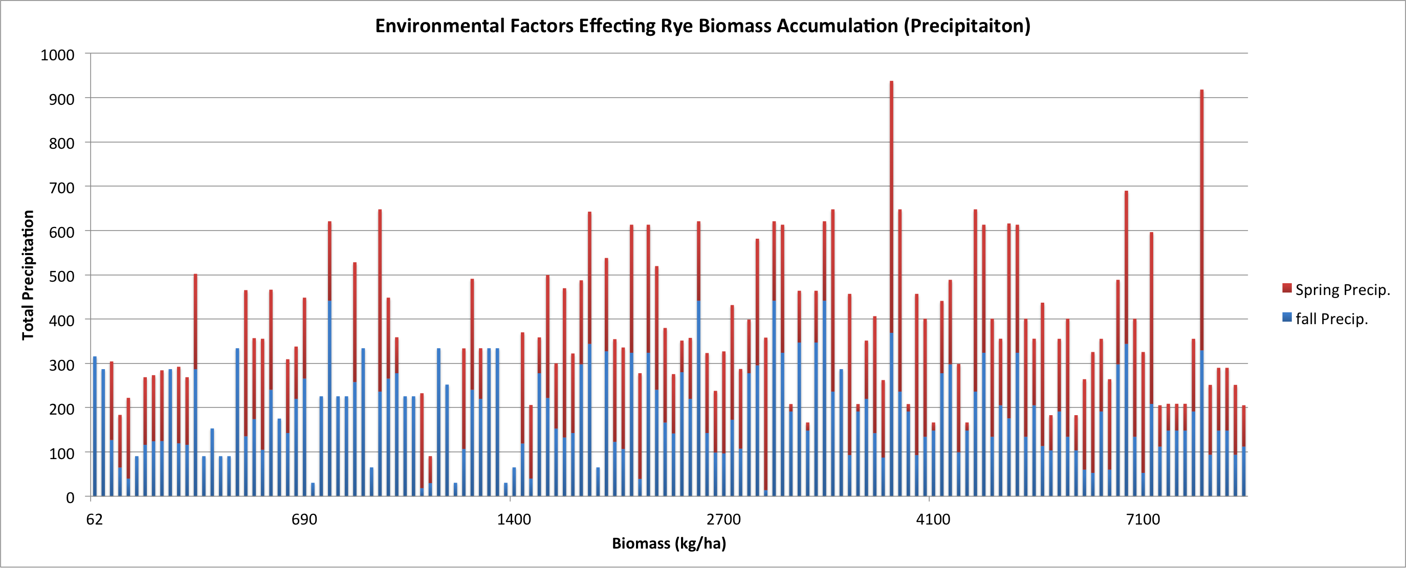


Predicting Winter Rye Cover Crop Biomass and Environmental Factors Impacting Growth
A. Hyler, A. Basche
SWP Student, Mentor
Science With Practice
Spring 2014
Introduction
Cereal rye, or winter rye, is a suitable plant species for use as a winter cover crop in Midwest cropping systems given its cold tolerance, ability to suppress weeds, reduce erosion and scavenge nitrogen in the soil. Much of the environmental benefits gained from a cover crop are dependent upon biomass accumulation during the winter growing window. Improving our understanding of the factors that limit winter rye growth will better allow for producer decision making on planting timing and methods that maximize environmental benefits and minimize cash crop yield impacts. For this project, the impact of two main environmental variables were investigated - precipitation and temperature via the calculation of growing degree days – to look for relationships with rye biomass accumulation. Ultimately this will help us better understand the limitations on winter rye growth as a cover crop in the Midwest.
Methods
We extracted data from Nuttonson (1958) who catalogued rye growth and development stages from experiments around the world. We noted the planting dates and dates to reach the heading stage of development and then calculated the thermal time required given the listed average monthly temperatures at each location. Further, an extensive literature review using Web of Science and Google Scholar was conducted to build a database of winter rye growth in the United States. Locations, planting dates, termination dates and biomass were indexed. Then, we used the National Oceanic and Atmospheric Agency’s Global Historic Climate Network database to pair locations with precipitation and temperature data during the rye growth period.
Figure 1. Both Fall and Spring GDD play a key role in biomass accumulation. This figure indicates Spring may be more important.
SWP Takeaway
Development of database knowledge and management
Utilization of online weather databases
Understanding of peer reviewed and primary literature sources
Time management
Goals
Develop tools to predict winter rye growth in the Midwest under varying environmental conditions.
Reviewing previous studies to compile relevant information on biomass accumulation, planting dates and termination dates
Create a database from the primary literature of winter rye growth
Extracting weather information from online databases to compare with other locations of winter rye.
Figure 2. No correlation between precip. and biomass from either Fall or Spring indicating precip. is not a key environmental factor.
Conclusion/Results
Our study has produced mixed results. About 63% of Rye’s GDD occurred during the fall period (Planting-December 31). The Fall GDD however, stays relatively constant compared to the increasing biomass amounts while the Spring GDD seems to be increasing along with increasing biomass amounts. This suggests that the Spring period may be the key to better understand the growth of rye. From the Nuttonson data understanding the amount of GDD’s needed to reach heading in other environments has helped to set limitations to what cultivars could be used here in the mid-west. This has opened up the possibility to further study individual cultivars to decide upon the best one to plant in certain situations to maximize the potential intentions of the rye cover crop (i.e., Erosion control, nitrogen uptake, or weed suppression).
Figure 3. Climate can effect the date of heading tremendously. Specific rye cultivars must be used to maximize an environment’s GDD potential.
(Nuttonson, M.Y. (1958). Rye-climate relationships and the use of phenology in ascertaining the thermal and photo-thermal requirements of rye. Washington, DC: American Institute of Crop Ecology.)

